Slide 1
SOLID PROPULSION TEAM REPORT WEEK 10
NAKUJA PROJECT

Slide 2
WEEK 10 OBJECTIVE
3D printing more new mold castings. #111
Calculation of the masses of components for cooking grains. #130
Cooking grains. #83
Calculation of bolts. #129
Calculations of motor casing thickness. #128
Motor casing boring. #131

Slide 3
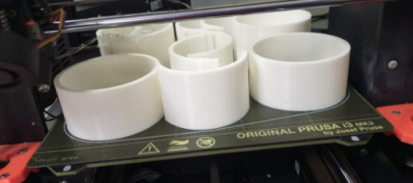
#111 3D PRINTING OF MORE NEW MOLD CASTING TOOLS.

Slide 4
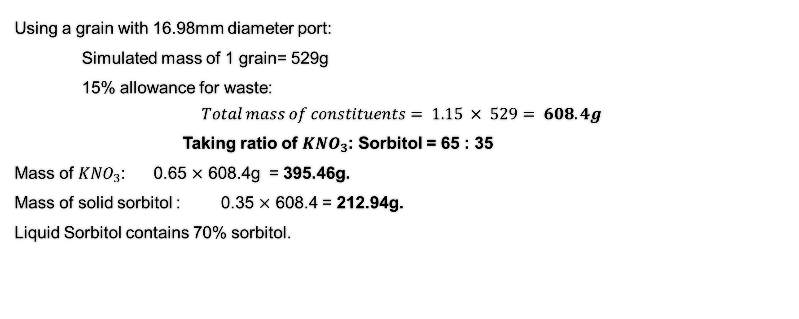
#130 Calculation of masses of cooking grains components.
Using a grain with 16.98mm diameter port:
Simulated mass of 1 grain= 529g
15% allowance for waste:
$$Total mass of constituents= 1.15 × 529= 608.4g$$
Taking ratio of ${KNO}_{3}$: Sorbitol = 65 : 35
Mass of ${KNO}_{3}$: 0.65 $×$ 608.4g = 395.46g.
Mass of solid sorbitol : 0.35 $×$ 608.4 = 212.94g.
Liquid Sorbitol contains 70% sorbitol.

Slide 5
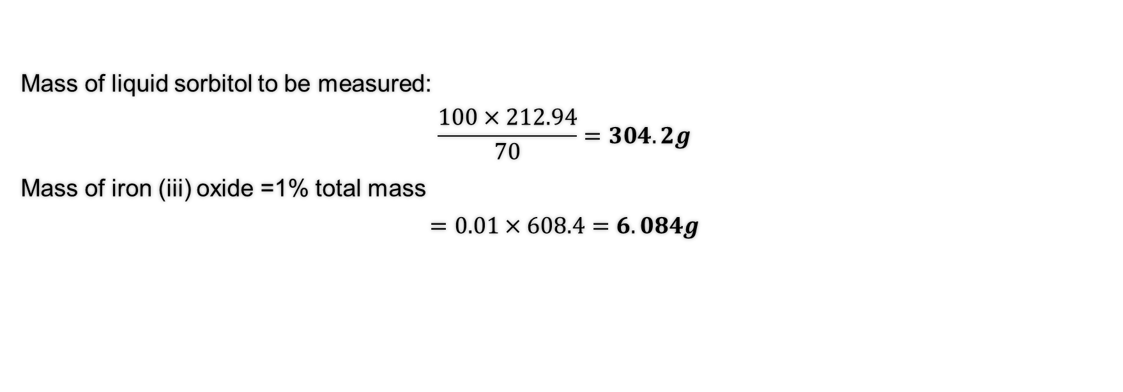
Continue
Mass of liquid sorbitol to be measured:
$$\frac{100×212.94}{70}=304.2g$$
Mass of iron (iii) oxide =1% total mass
$$=0.01×608.4=6.084g$$

Slide 6
Continue
For cooking one grain the following measurements shall be used:
ELEMENT | MASS (g)
POTASSIUM NITRATE | 395.46
SORBITOL | 304.2
IRON(iii) OXIDE | 6.084

Slide 7
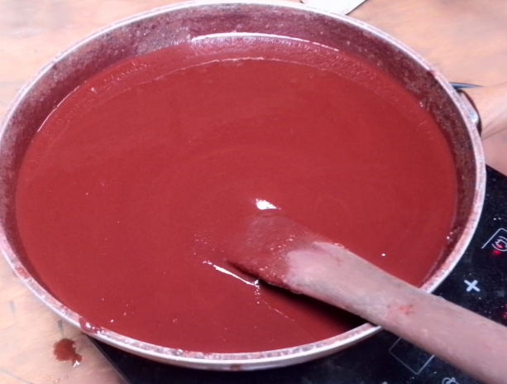
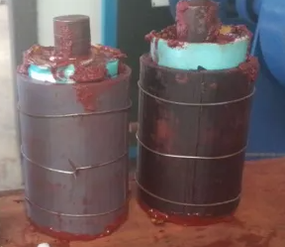
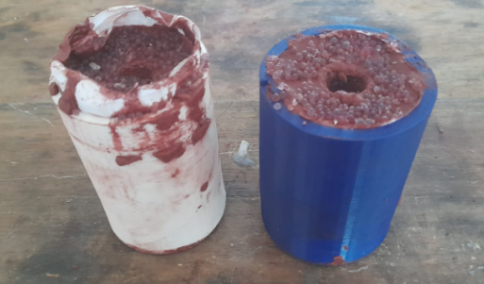
#83 COOKING GRAINS
Cooked 2 grains using 16.98mm port diameter
Cooked 2 grains using 25mm diameter.

Slide 8
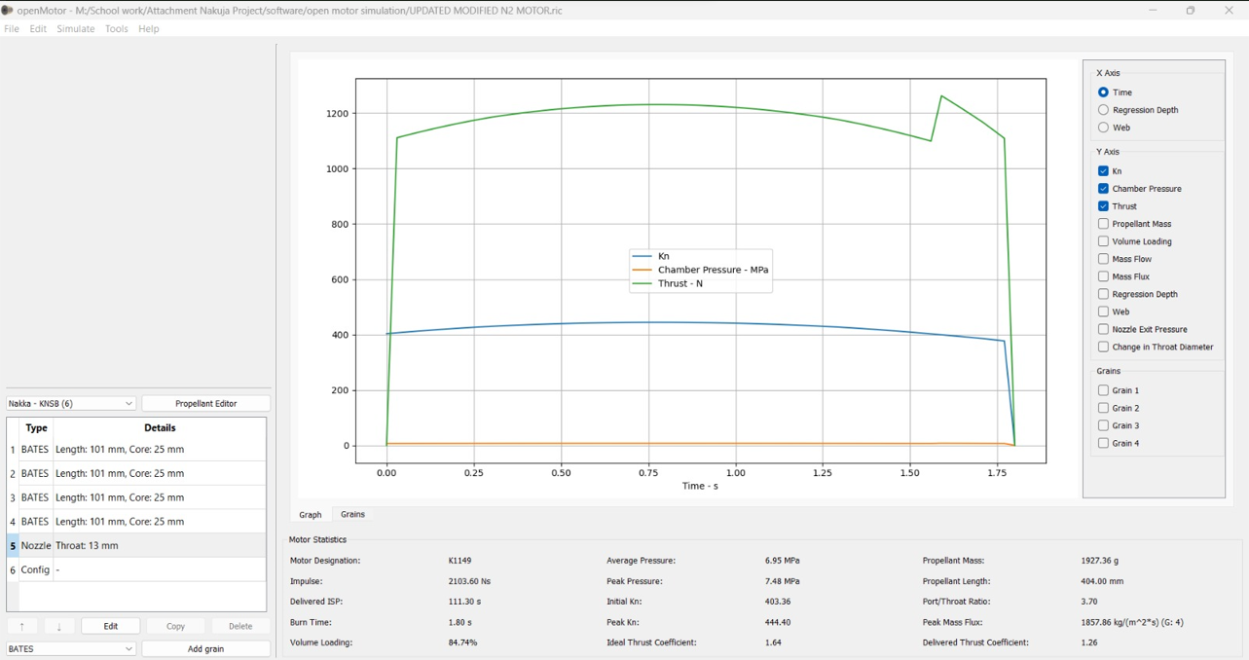

Slide 9
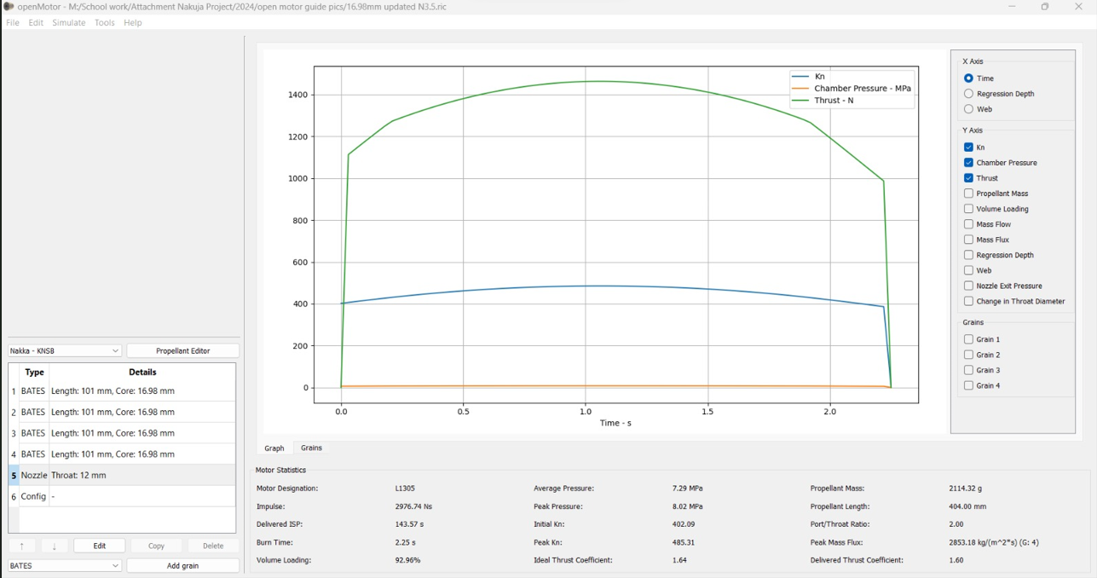

Slide 10

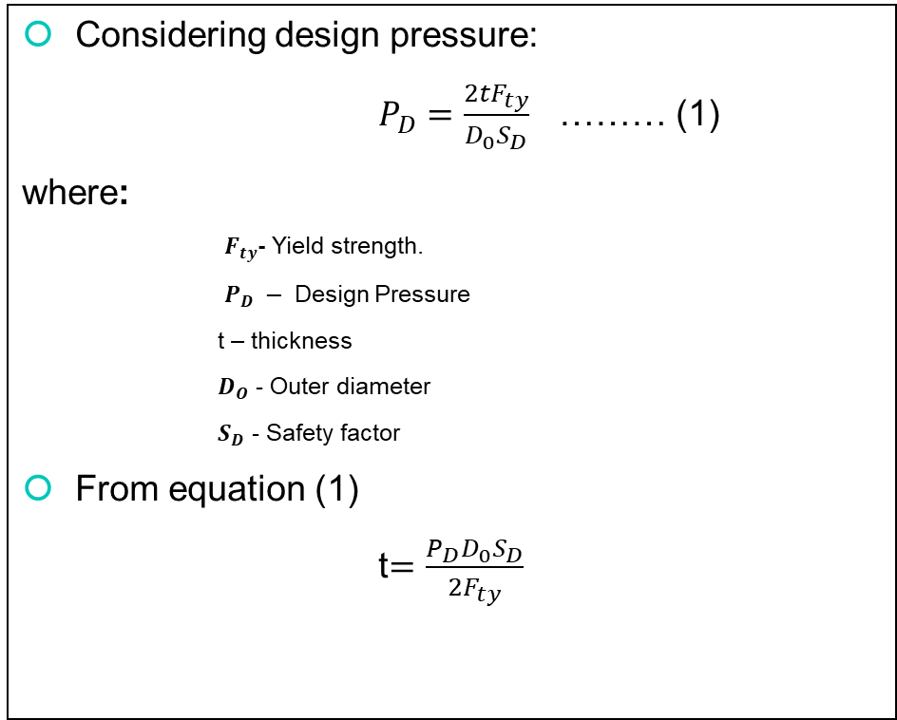
#128 Calculations of motor casing thickness.
Considering design pressure:
$P_{D}=\frac{2tF_{ty}}{D_{0}S_{D}}$ ……… (1)
where:
$F_{ty}$- Yield strength.
$P_{D} −$ Design Pressure
t – thickness
$D_{O}$ - Outer diameter
$S_{D}$ - Safety factor
From equation (1)
t$=\frac{P_{D}D_{0}S_{D}}{2F_{ty}}$
For:
$P_{D}$ = 8.02 Mpa
$D_{O}$= 73mm
$S_{D}$= 1.87
$F_{ty}$= 220MPa
t$=\frac{8.02 ×73×1.87}{2×220}$
= 2.488 mm
t =2.5mm
Thus $D_{outer}$ = 73mm
$D_{inner}$ = 68mm
t = 2.5mm

Slide 11

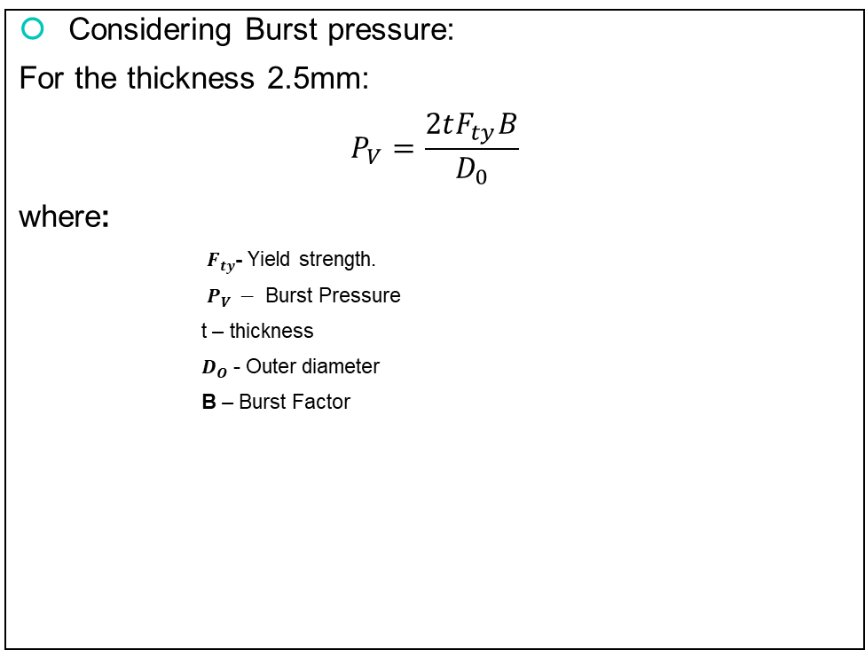
Continued
Considering Burst pressure:
For the thickness 2.5mm:
$$P_{V}=\frac{2tF_{ty}B}{D_{0}}$$
where:
$F_{ty}$- Yield strength.
$P_{V} −$ Burst Pressure
t – thickness
$D_{O}$ - Outer diameter
B – Burst Factor
For:
t= 2.5mm
$D_{O}$= 73mm
B= 1.726
$F_{ty}$= 220MPa
$$P_{V}=\frac{2×2.5×220×1.726}{73}$$
= 26.0082MPa
=26MPa

Slide 12
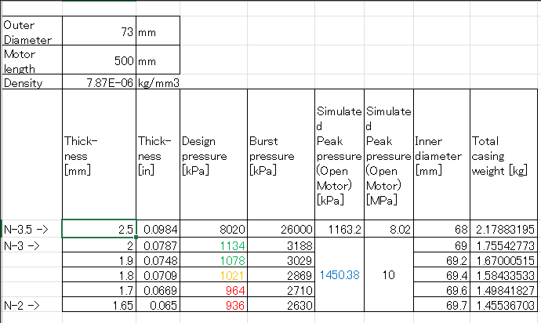
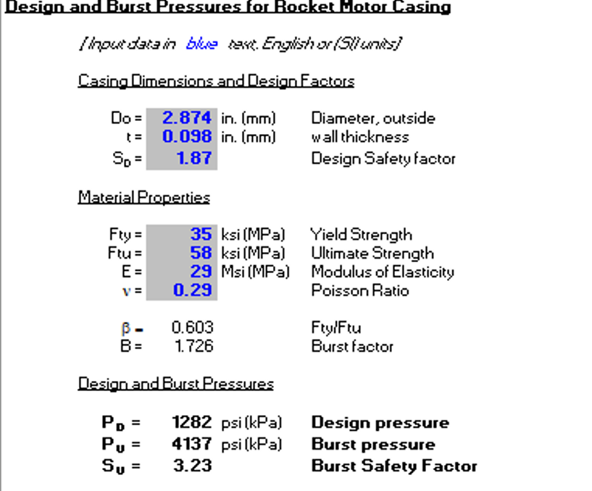
https://www.nakka-rocketry.net/softw.html

Slide 13
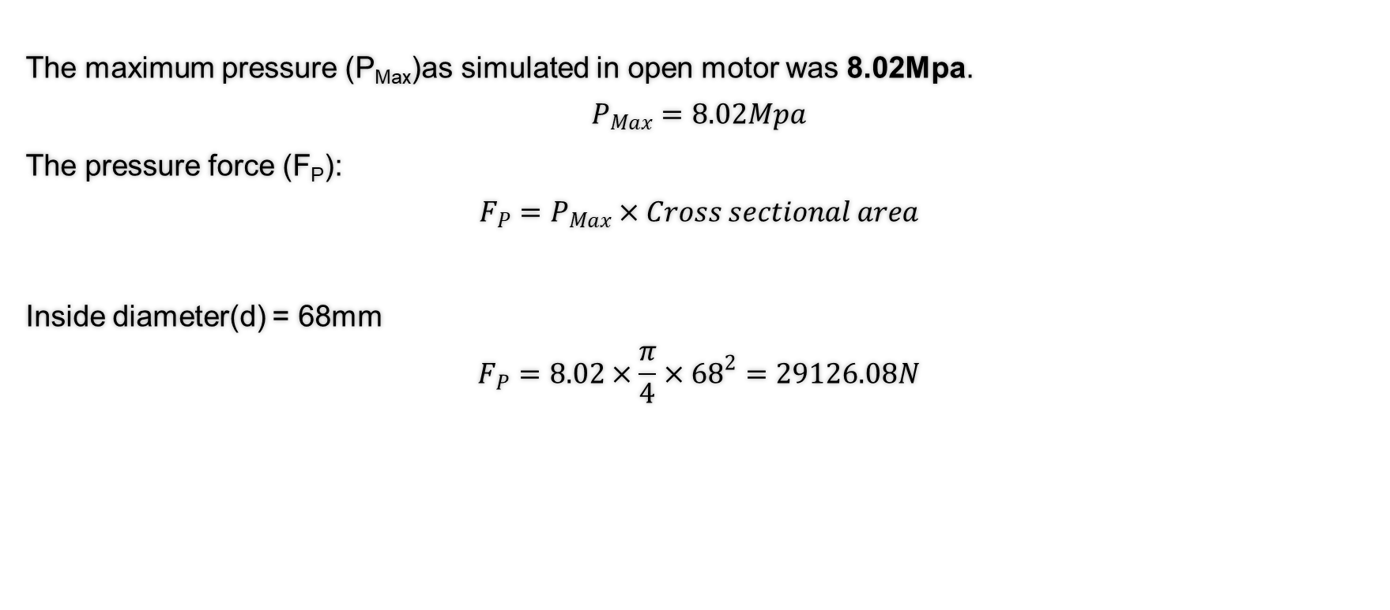
#129 CALCULATION OF BOLTS
The maximum pressure (P_{Max})as simulated in open motor was 8.02Mpa.
$$P_{Max}=8.02Mpa$$
The pressure force (F­­_{­P}):
$$F_{P}=P_{Max}×Cross sectional area$$
Inside diameter(d) = 68mm
$$F_{P}=8.02×\frac{π}{4}×{68}^{2}=29126.08N$$

Slide 14
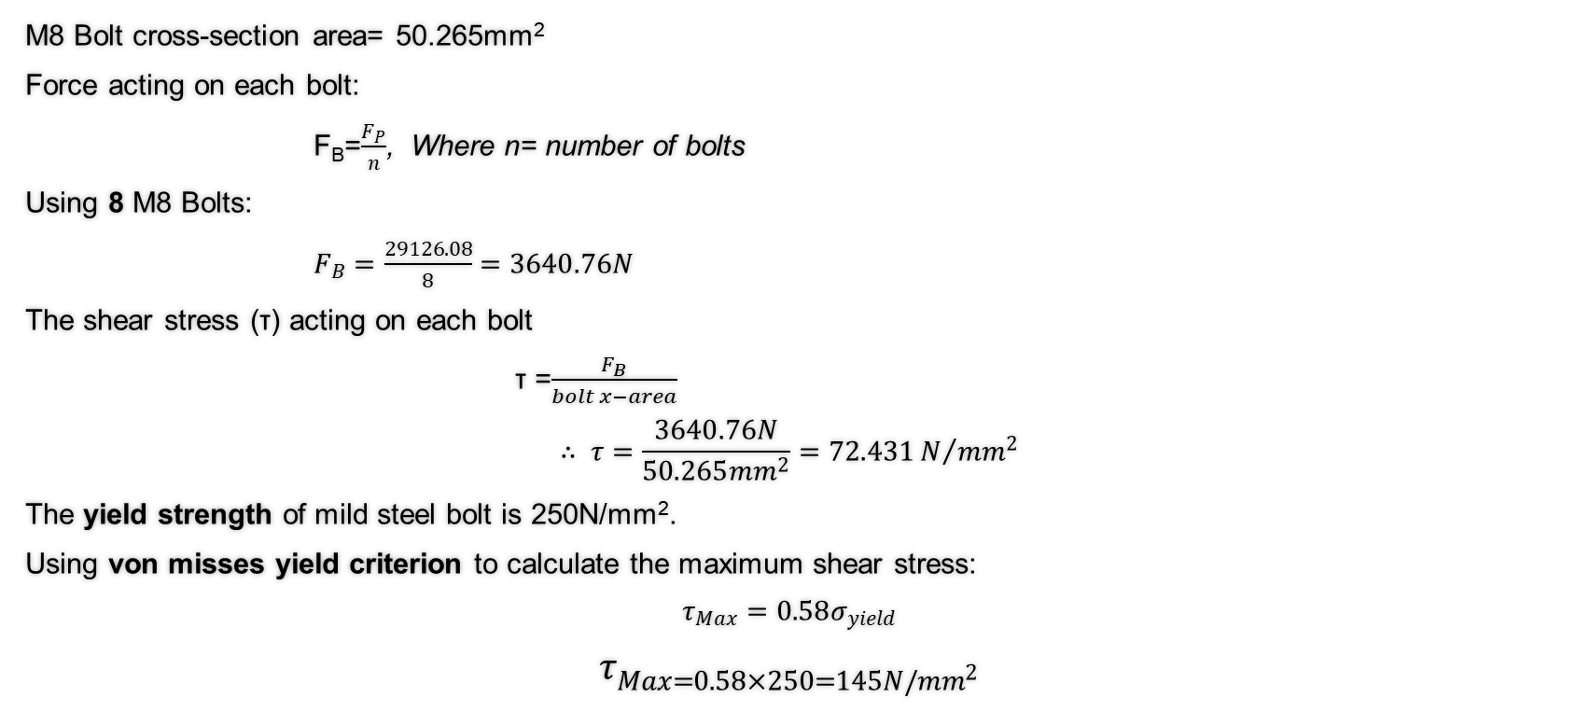
Continue
M8 Bolt cross-section area= 50.265mm²
Force acting on each bolt:
F­_{B}=$\frac{F_{P}}{n}$, Where n= number of bolts
Using 8 M8 Bolts:
$F_{B}=\frac{29126.08}{8}=3640.76N$
The shear stress (τ) acting on each bolt
τ =­­$\frac{F_{B}}{bolt x−area}$
$$∴ τ=\frac{3640.76N}{50.265{mm}^{2}}=72.431N/{{mm}^{2}}$$
The yield strength of mild steel bolt is 250N/mm².
Using von misses yield criterion to calculate the maximum shear stress:
$$τ_{Max}=0.58σ_{yield}$$
$$τ_{Max=0.58×250=145N/{mm}^{2}}$$

Slide 15
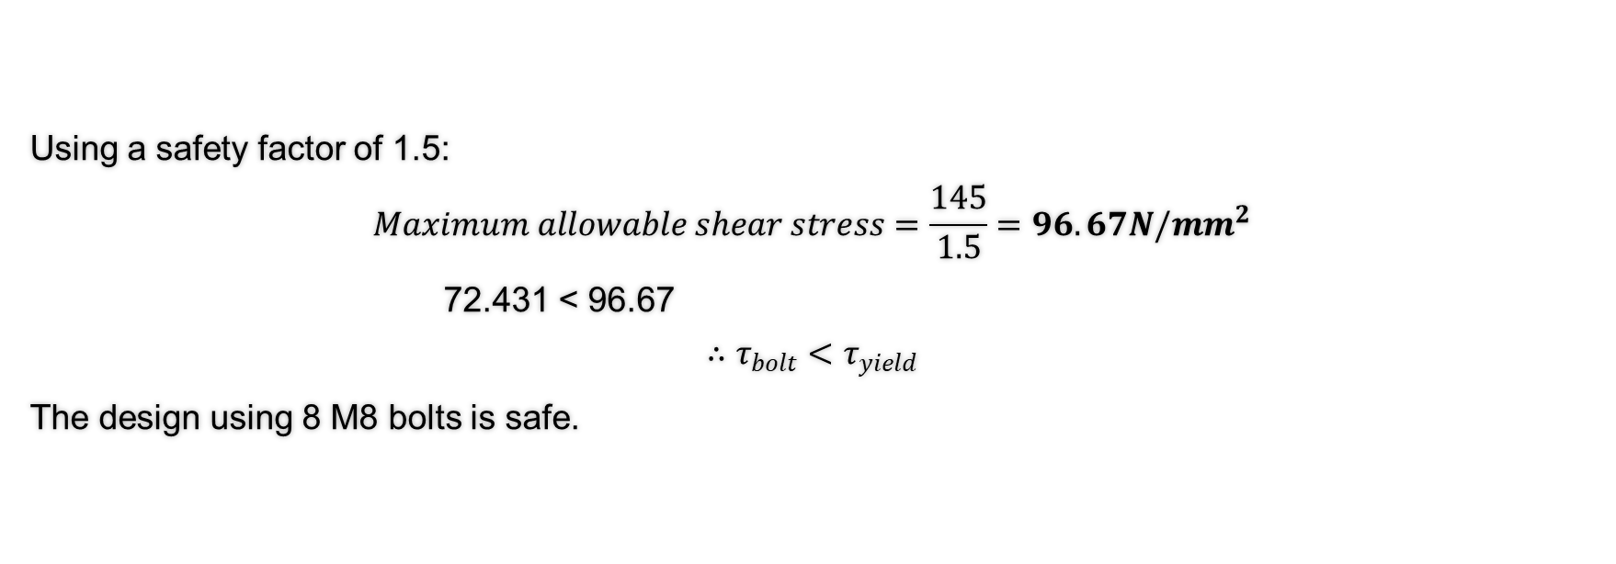
Continue
Using a safety factor of 1.5:
$$Maximum allowable shear stress=\frac{145}{1.5}=96.67N/{mm}^{2}$$
72.431 < 96.67
$$∴τ_{bolt}<τ_{yield}$$
The design using 8 M8 bolts is safe.

Slide 16
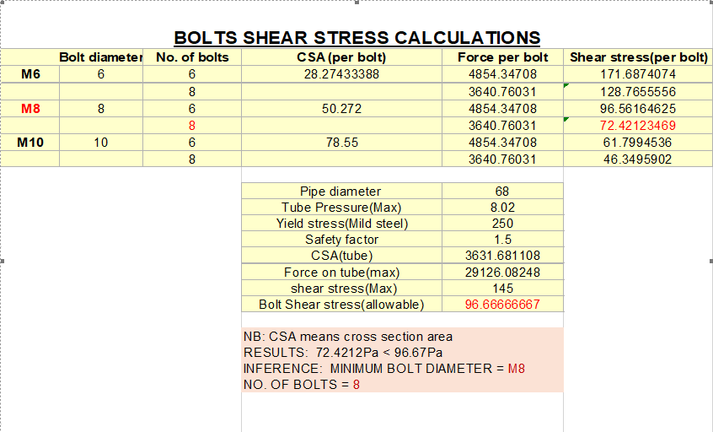
Comparison of the maximum allowable stress to different bolt sizes for optimum design

Slide 17
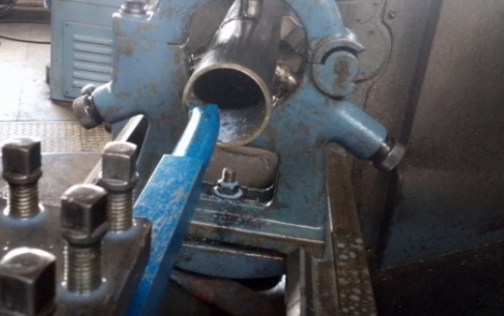
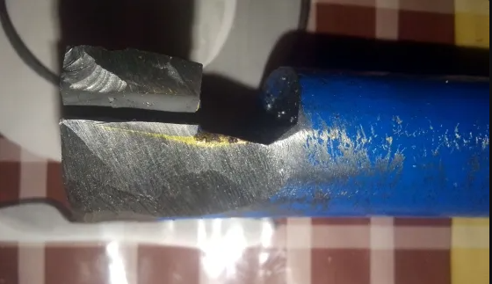
#131 Motor casing boring.
Boring of motor casing.
Broken boring tool

Slide 18
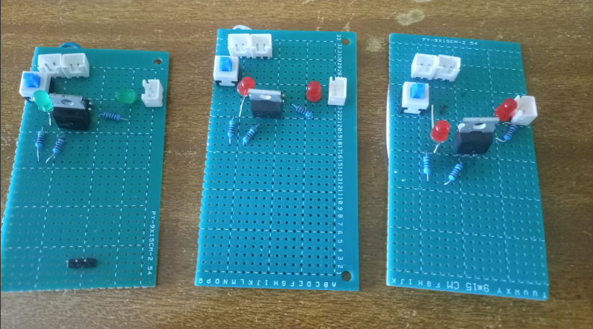
IGNITION CIRCUIT
Added JST connectors.

Slide 19
CHALLENGES
Melting of casting tools – Increase the infill to 70%.
Destroyed load cell – Purchase of new load cell
Broken boring tool.
Purchase of new ESPs.

Slide 20
NEXT WEEK’S OBJECTIVES
Boring of motor casing.
Purchase more ESPs and load cell.
Repair of the motor holder and test stand.
3D printing more casting tool.
Cooking grains.
Making ignitors.

Slide 21
THANK YOU

